Slide 1
Starter 1/31/11
Please answer each question with complete sentences. (3 sentences each for full credit.)
1. The most important or interesting thing that I have learned in this unit is…
2. The best activity I’ve done was…

Slide 2
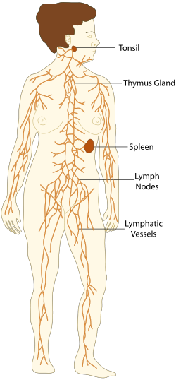
The Lymphatic System
The lymphatic system is part of the immune system made up of a series of channels, called lymphatic vessels, that carry a clear fluid called lymph toward the heart.

Slide 3
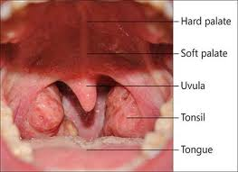
When you go to the doctor and he/she feels your throat, why are they doing this?
Tonsils are a part of the lymphatic system.
First line of defense against ingested or inhaled foreign objects (viruses, bacteria)

Slide 4
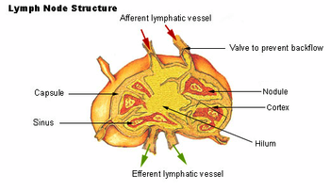
Lymphatic tissue is found throughout the body
Bone marrow is the main lymph tissue in your body
A lymph node is an organized collection of lymph tissue

Slide 5
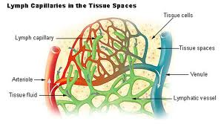
So how does it work?
Tiny vessels carry a fluid called lymph out of tissues
The lymphatic system removes toxins, dead cells, and excess fluid from tissues and interstitial fluid (fluid that bathes our cells in our tissues)
Works with the circulatory system to transport wastes and defense cells

Slide 6
http://www.youtube.com/watch?v=qTXTDqvPnRk

Slide 7
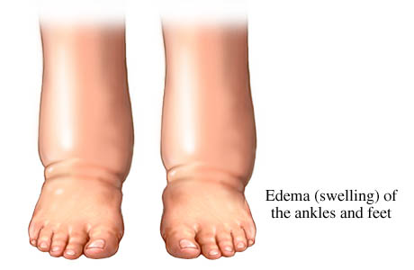
How is fluid moved?
Contraction of skeletal muscles against lymphatic vessels
Smooth muscle contraction
Valves in lymphatic vessels
Breathing
Obstruction of system
leads to edema

Slide 8
Compare and Contrast
Lymph vs. Blood
Cardiovascular system (Blood) | Lymphatic System (Lymph)
Blood is responsible for collecting and distributing oxygen, nutrients and hormones to the tissues of entire body. | Lymph is responsible for collecting and removing waste products left behind in the tissues.
Blood flows in a closed continuous loop throughout the body via the arteries, capillaries, and veins | Lymph flows in an open circuit from the tissues into lymphatic vessels. Once within these vessels, lymph flows in only one direction.

Slide 9
Circulatory | Lymphatic
Blood is pumped. The heart pumps blood into the arteries that carry it to all of the body. Veins return blood from all parts of the body to the heart. | Lymph is not pumped. It passively flows from the tissues into the lymph capillaries. Flow within the lymphatic vessels is aided by other body movements such as deep breathing and the action of nearby muscles and blood vessels.
Blood consists of the liquid plasma that transports the red and white blood cells and platelets. | Lymph that has been filtered and is ready to return to the cardiovascular system is a clear or milky white fluid.
Blood is visible and damage to blood vessels causes obvious signs such as bleeding or bruising. | Lymph is invisible and damage to the lymphatic system is difficult to detect until swelling occurs.
Blood is filtered by the kidneys. All blood flows through the kidneys where waste products and excess fluids are removed. Necessary fluids are returned to the cardiovascular circulation. | Lymph is filtered by lymph nodes located throughout the body. These nodes remove some fluid and debris. They also kill pathogens and some cancer cells.

Slide 10
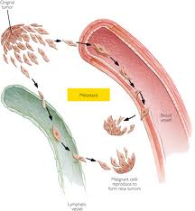
When things go wrong with the lymphatic system….
Metastasis
The lymphatic system is often responsible for spreading cancer because it is close to almost all of our tissues and blood vessels

Slide 11
Major Review
The Heart
What are the steps of blood flow through the circulatory system.
Blood enters the heart through the inferior and superior vena cava.
Blood flows into the right atrium.
Blood flows into the right atrium.
Blood flows through the pulmonary arteries to the lungs.
Blood flows through the pulmonary veins to the left atrium.
Blood flows into the left ventricle.
Blood flows through the aorta to the entire body.
http://www.youtube.com/watch?v=nx-XRC_1n-Q

Slide 12
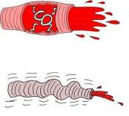
Vasoconstriction
Narrowing of the blood vessels
Drugs like antihistamines, decongestants, and stimulants
Caffeine
Cold
Vasodilation
Widening of the blood vessels
Histamines (natural chemicals your body releases when it’s injured or invaded)
Drugs like opiates, alcohol
Heat

