Slide 1
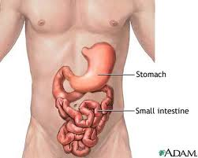
The Intestine

Slide 2
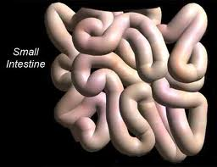
Small Intestine
Between the stomach and large intestine
Where most digestion and absorption happens
19 feet long

Slide 3
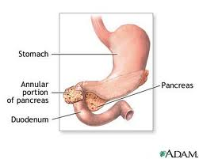
Parts of the small intestine
Duodenum: first section of the small intestine
10-12 inches long
Releases enzymes to break down food
Regulates the emptying of the stomach

Slide 4
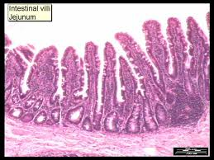
Jejunum
Jejunum: middle section of the small intestine
2.5 m long
If the jejunum is hit hard, the vomit reflex will start
Covered in villi for absorption

Slide 5
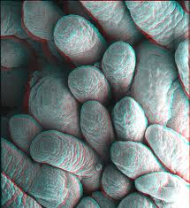
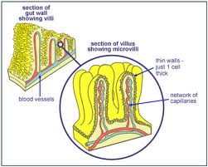
Villi
Tiny, finger-like projections that stick out from the lining of the intestines
Greatly increase the surface area so more nutrients can be absorbed

Slide 6
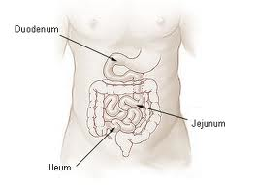
Illium
Illium: final section of the small intestine
2-4 m long
Main job is to absorb vitamin B-12 and bile salts

Slide 7
Large Intestine
Final part of the digestive system
Extracts water and salt from solid waste
Ascending colon: on the right side of the abdomen
Transverse colon: goes across the top, horizontally
Descending colon: descends down the left side of abdomen to the colon

Slide 8
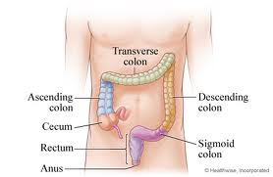
Large Intestine

Slide 9
Colon
Sigmoid Colon: part of the colon before the rectum
Muscular walls push fecal matter into the rectum
http://www.youtube.com/watch?v=15JsYSZIT-Q&safety_mode=true&persist_safety_mode=1

Slide 10
Colon Cancer
Causes 655,000 deaths per year
Very treatable if caught early
Very deadly if caught late
http://www.youtube.com/watch?v=vVqgtUHP2z8&safety_mode=true&persist_safety_mode=1

Slide 11
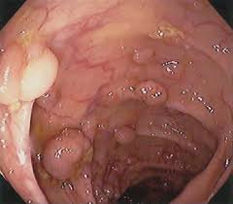
Polyps
Adenomatous Polyps: mushroom-shaped growths in the colon that can easily be removed
Usually benign (non-cancerous)
If left un treated, may turn into cancer

Slide 12

What causes colon cancer?
APC gene: tumor suppressor that puts on the brakes in the cell cycle
If APC is turned off, the cells continue to divide uncontrollably
APCmin mouse colon

Slide 13
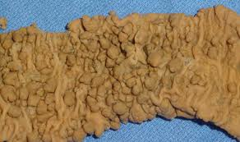
What causes colon cancer?
FAP: Familial Adenomatous Polyposis
Genetic disorder that results in colon cancer at an early age
Polyps can begin forming in the teen years
Caused by mutation in APC or MUTYH gene

Slide 14
Symptoms
Unfortunately, symptoms don’t appear until tumors have progressed to a dangerous point
Blood in stool
Constipation
Anemia
Weight loss
Abdominal pain

Slide 15
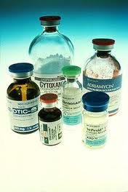
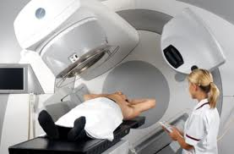
Treatment
Removal of polyps and tumors
Chemotherapy
Radiation

Slide 16
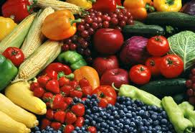
Prevention
Colonoscopy at age 50
Diet full of fruits and veggies
Diet low in animal fat
Maintain a healthy weight
Be active
Know your family history
Don’t smoke
Reduce radiation exposure

Slide 17
GI Disorder Pamphlet
Create a pamphlet like you see in doctors’ offices for a GI disorder
You must include:
  Name of disorder
  Symptoms
  Causes
  Treatment
  Prevention
  Diagram or picture of some sort

