Slide 1
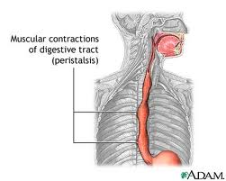
Peristalsis

Slide 2
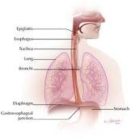
Esophagus
The muscular tube that food passes through which connects the pharynx to the stomach

Slide 3
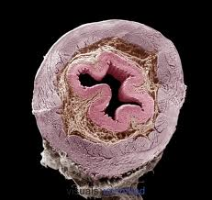
Layers of the esophagus
Muscularis externa
mucosa
submucosa

Slide 4
Layers of the esophagus
Mucosa: innermost layer of the esophagus that is made of epithelial tissue that sloughs off often
Submucosa: contains mucous secreting glands
Muscularis externis:
  Top 1/3 is voluntary muscle
  Bottom 2/3 is involuntary muscle

Slide 5
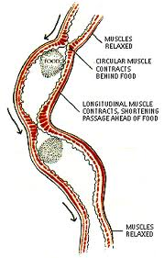
Peristalsis
Peristalsis: The rhythmic contraction and relaxation of the esophageal muscles which pushes food down to the stomach
YouTube: Peristalsis after a bowl of corn pops

Slide 6
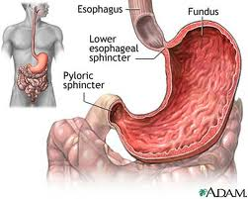
Lower Esophageal sphincter
LES: separates the esophagus from the stomach
Helps contain stomach contents including acidic juices

Slide 7
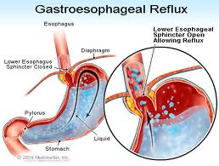
GERD
Gastroesophageal Reflux Disease
Caused by stomach acid flowing backward through the lower esophageal sphincter
May be caused by abnormal relaxation of the LES or hiatal hernia

Slide 8
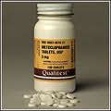
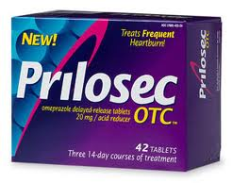
Treatment of GERD
Medications that turn off acid pumps in the stomach (Prilosec, Nexium)
Medications that make the stomach empty faster (Reglan)
Surgery to repair the sphincter or hiatal hernia

