Slide 1
Either Ur-ine or Your Out
And the Story of the Urinary System

Slide 2
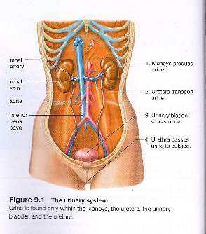
Urinary System
Where is urine found?

Slide 3
What structures contain urine?
Ureter
Kidney
Urinary bladder
Inferior vena cava
Renal vein
Urethra
Aorta
rectum

Slide 4
Organs of the Urinary System
Kidneys – Major organ of the urinary system
  What do kidneys do? How many kidneys?
Ureters – tubes with smooth muscle connecting kidneys to bladder
  What do Ureters do? How many Ureters?
Urinary Bladder – sac with a layer of circular fibers and 2 layers of longitudinal muscle
  What does the Bladder do? How many bladder openings?
Urethra – Small tube that extends from the bladder to an external opening
  What does the Urethra do? How many sphincters on the Urethra?

Slide 5
Major Functions of the Urinary System
Excretion of Metabolic Wastes
Maintenance of Water-Salt Balance
Maintenance of Acid Base Balance
Secretion of Hormones
Page 160 in your book!

Slide 6
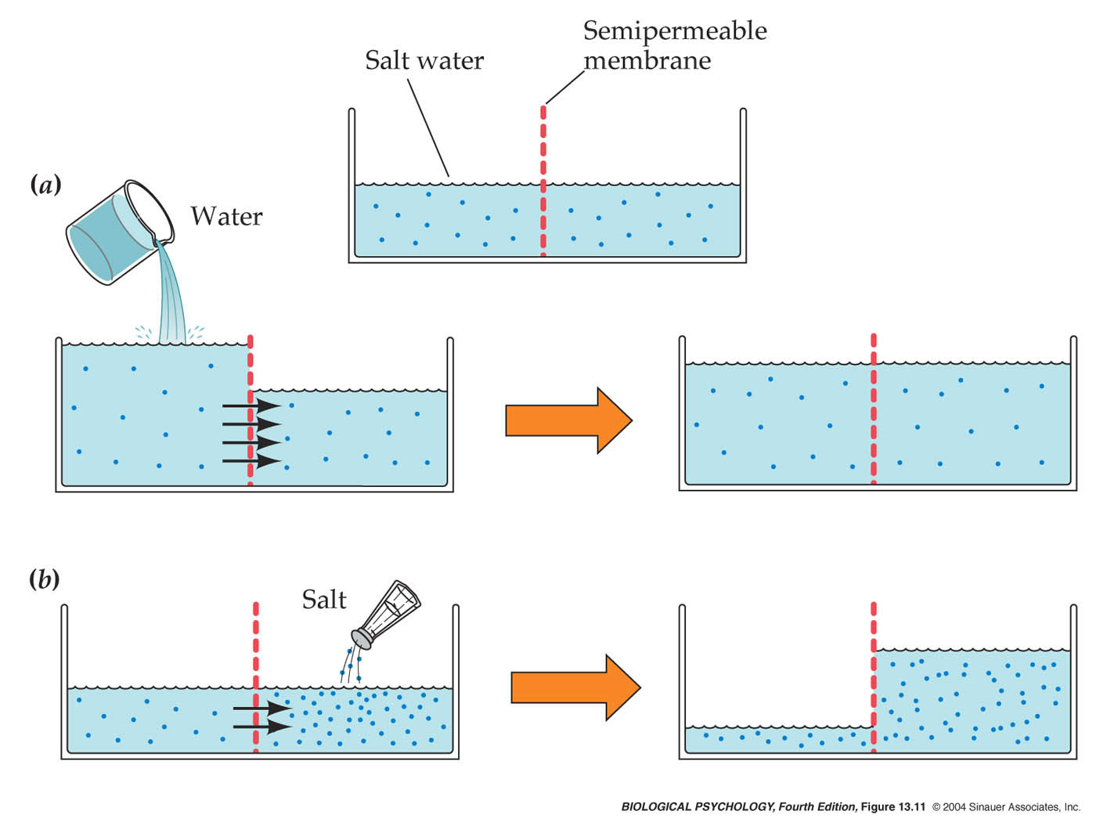
Osmosis Reviewed

Slide 7
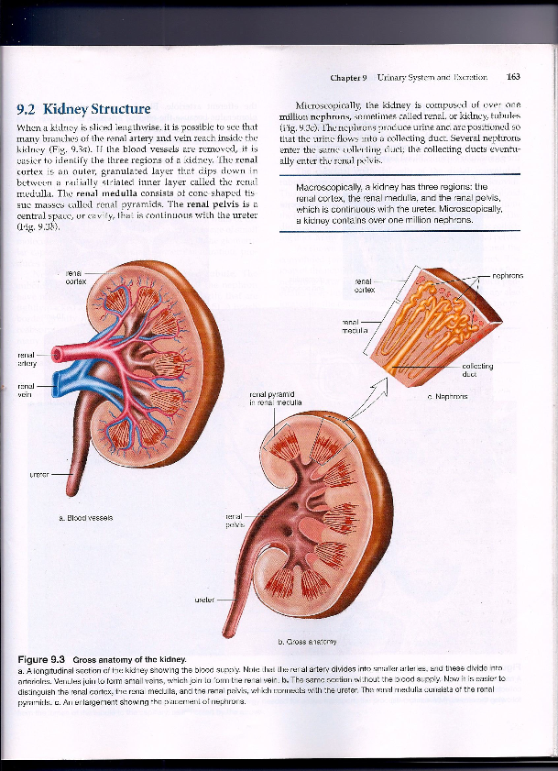

Slide 8
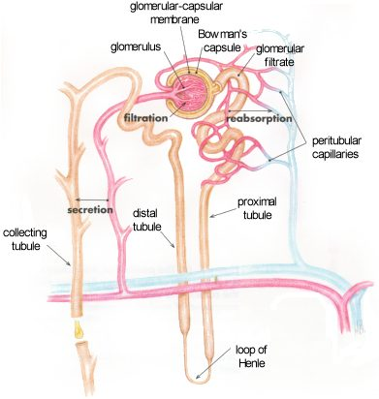

Slide 9
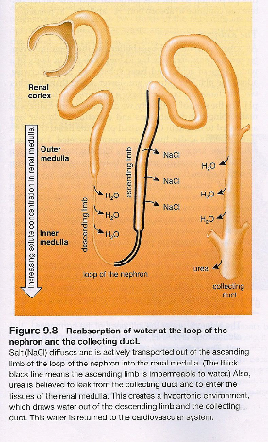

Slide 10
Tubular Reabsorption
Nutrient and salt molecules are actively reabsorbed from the convoluted tubules into the peritubular capillary network, and water follows passively.
Glomerular Filtration
Tubular Secretion
Water, salts, nutrients molecules, & waste molecules move from the glomerulus to the inside of the glomerular capsule.
Certain Molecules are actively secreated from the peritubular capillary network into the convoluted tubules.

Slide 11
3 main steps in Urine Formation

